Slide 1
Boom and Bust: The Story Behind the Great Depression
OPTIMISM “happy days are here again” to DESPAIR “brother, can you spare a dime”

Slide 2
In the 1920s …
American investors had “money to burn”
The government favoured ‘big business’
Government followed policy of isolationism and protectionism

Slide 3
Government and Business were “tight”…
President Calvin "Silent Cal" Coolidge said
it best:
“Wealth is the chief end of man!"
"The man who builds a factory, builds a
temple. The man who works there,
worships there."

Slide 4
Boom
‘the rich got richer and the poor became even poorer’
laissez-faire or ‘hands off’ business
Protectionism
Mass Production
Buying on Credit
Stock Market Speculation

Slide 5
Government Perception ...
“A chicken in every pot and two cars
in every garage.”
“The poorhouse is vanishing from
among us.”
President Hoover

Slide 6
What did this mean?
Business monopolies created
Increased manufacturing
Minimum wage legislation defeated
Production costs fell
Wages rose slowly
Prices remained constant
Corporations made ‘a killing’

Slide 7
Warnings ignored …
In a balanced economy,
demand must equal the
production of goods!
People have no
money to spend
on new goods
Surplus goods
start to pile up
Credit leads to false information and production soon exceeds consumers’ ability to buy.
Industry produces
more because of
perceived demand
Low wages seen
as a way to cut
production costs
People spend
beyond ability
to pay
People could
not afford
luxury items
Credit Buying
seen as the
solution

Slide 8
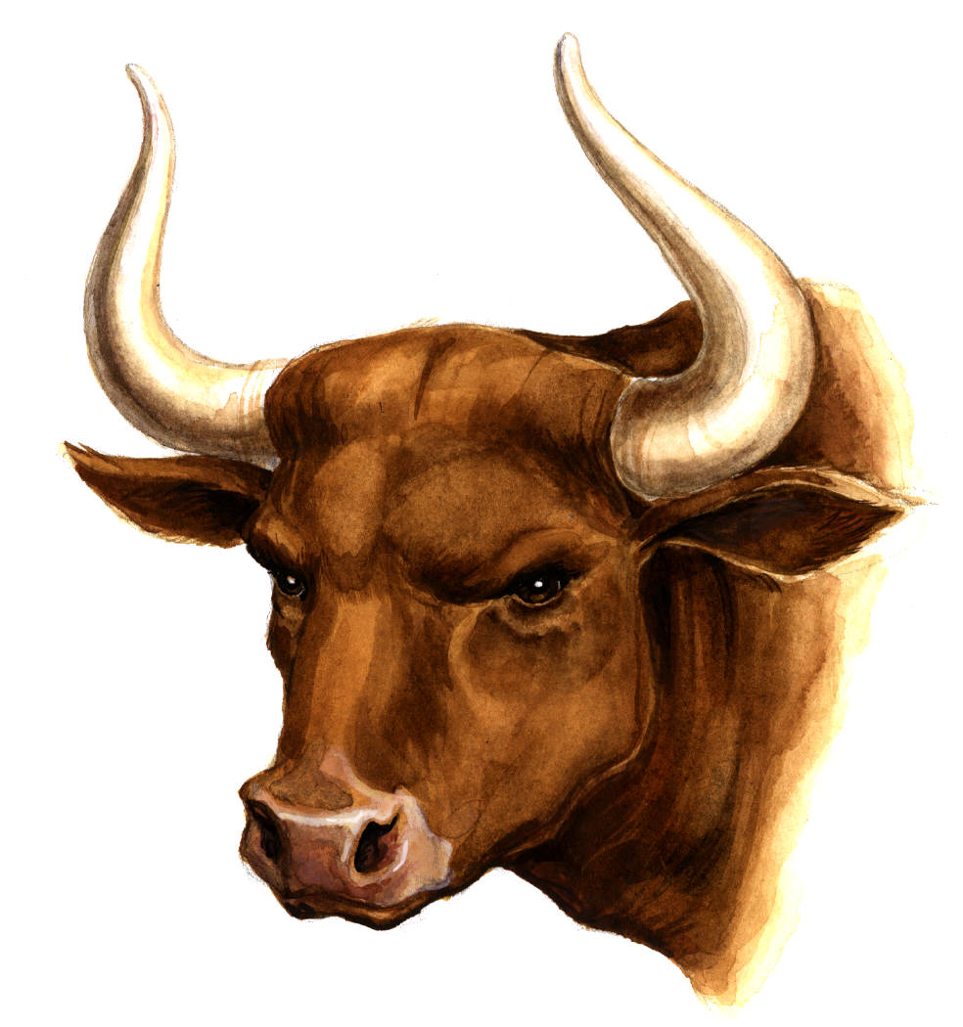


In the Stock Markets…
Share prices kept rising!
Fortunes were made overnight!

Slide 9

Stock Market Speculation
Stock prices did not reflect company profits
Investors based decisions on potential profits
Brokers let people buy ‘on margin’
(future profit would pay loan)
Everybody could get in on the
action
Most of the money invested did
not really exist!

Slide 10
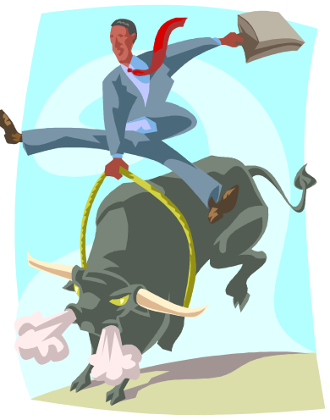
Investors, we have ourselves a bull market!
People invested all their savings on this “sure thing”
Banks gave loans to lower income groups
Companies expanded
Companies printed unlimited common stocks

Slide 11
The Story below the BOOM
Wealth was not circulating…
entire sections of the economy
were depressed throughout the
decade.

Slide 12
Beneath the ‘Boom’
During WWI, government subsidized farms to increase production, and modernize methods. After WWI government eliminated farm subsidies and gave them to big business. Grain prices fell from $2.00/bushel to $0.67/bushel. Result: Farmers had huge debts and no way to pay them.
Many African Americans worked in textiles and farming. They lost their jobs to machines. Many moved North looking for work in the factories.
Recent immigrants were given low paying jobs and lived in overcrowded conditions.
American market focussed on the sale of automobiles and radios. Workers in mining, textiles and energy industries were paid low wages.

Slide 13
Beneath the ‘Boom’
50% of American families earned less than $2000 a year.
75% of the population spent almost all of their annual income on food, clothing, radios and cars.
One-tenth of Americans earned more than the bottom 42% of Americans.
The US economy relied on credit sales, luxury spending and investments from the rich.

Slide 14

A bear appears…
20 million shareholders
by summer 1929
Car and Steel Production falls
Share Prices
set records
Profits Fall
Bull becomes a Bear
Experts start to
worry
People start to Sell
their Shares

Slide 15
The Crash Looms
October 19 – 24, 1929 millions of shares were sold.
October 25 - Top bankers support the market and buy millions of shares for more than they are worth.
October 26, 1929
President Hoover tells the American public:
“The fundamental business of the country is on a
sound and secure basis.”

Slide 16
The Sky is Falling…
October 28
Massive selling
NINE MILLION shares sold by day’s end
Banks stop supporting prices

Slide 17

Black Tuesday
October 29, 1929
16 million shares sold.
No buyers found.
Ticker tape machines break
due to pressure.
Many investors and banks are ruined.

Slide 18
Bust
It’s Official…
Millions of shares are worthless
The Market Crashes!

